Slide 1

1
SECURE DATA HIDING IN IMAGE
Presented By : Siddhartha Kunwar
AICTE INTERNSHIP PROJECT

Slide 2
2
OVERVIEW
Introduction
WOW Factor
Conclusion
Problem Statement
End Users
Github Link
Abstract
Implementation
Future Scope
Technology used
Result
Thank You
AICTE INTERNSHIP PROJECT

Slide 3
3
PROBLEM STATEMENT
Steganography provides a way to hide data within images, making it undetectable.
This project addresses secure data hiding using AES encryption and LSB steganography.
First Problem
Sensitive data needs secure transmission over untrusted channels.
AICTE INTERNSHIP PROJECT
Second Problem
Traditional encryption methods are vulnerable to attacks.

Slide 4
4
ABSTRACT
In an era where sensitive data transmission over untrusted channels faces escalating risks, traditional encryption methods alone are increasingly vulnerable to sophisticated attacks. This project proposes a hybrid security framework that integrates Advanced Encryption Standard (AES) for robust data encryption and Least Significant Bit (LSB) steganography for covert data concealment within digital images.
AICTE INTERNSHIP PROJECT

Slide 5
5
TECHNOLOGY USED
Libraries :
Platforms :
OpenCV (cv2) - image processing.
Crypto - AES encryption.
Hashlib - password hashing.
numpy - numerical operations.
Python programming language.
Streamlit for building the user interface.
AICTE INTERNSHIP PROJECT

Slide 6
6
WOW FACTORS
1
Combines AES encryption with LSB steganography for enhanced security.
2
Password-based authentication ensures only authorized users can decode the message.
AICTE INTERNSHIP PROJECT
3
Real-time encoding and decoding via a user-friendly Streamlit app
4
Supports PNG images for lossless data embedding.
5
Secure and undetectable data hiding, making it ideal for sensitive applications.

Slide 7
7
END USERS
Individuals :
For securely sharing private information (e.g., passwords, documents).
Organizations :
For confidential communication and data protection.
AICTE INTERNSHIP PROJECT

Slide 8
8
END USERS
Government Agencies :
For secure transmission of classified information.
Researchers :
For experimenting with advanced steganography techniques.
AICTE INTERNSHIP PROJECT

Slide 9
9
IMPLEMENTATION
Features:
Implementation provides:
Military-grade AES-256-CBC encryption
Secure key derivation with PBKDF2
Automatic message length detection
Support for multiple image formats
Detailed error reporting
Visual feedback for all operations
Proper memory management
Tamper detection
Size validation
Better security through proper cryptographic practices
More reliable data embedding/extraction
Improved user experience
Better error handling
Cross-platform compatibility
Proper handling of different image types
Defense against common steganalysis techniques
AICTE INTERNSHIP PROJECT

Slide 10
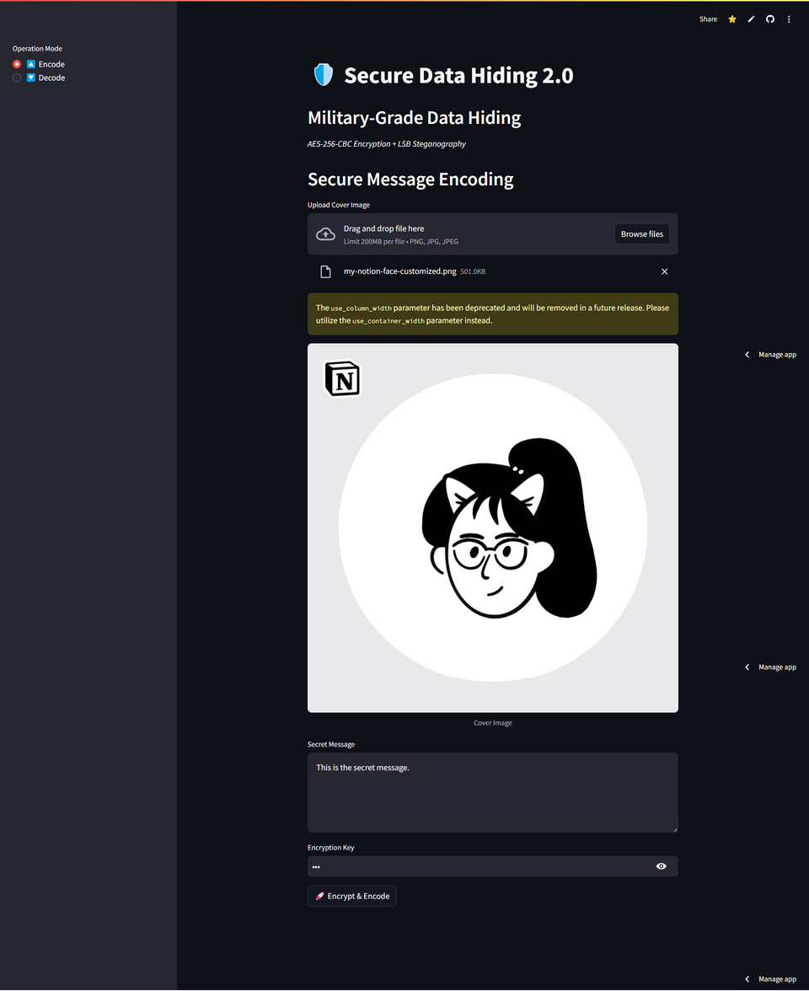
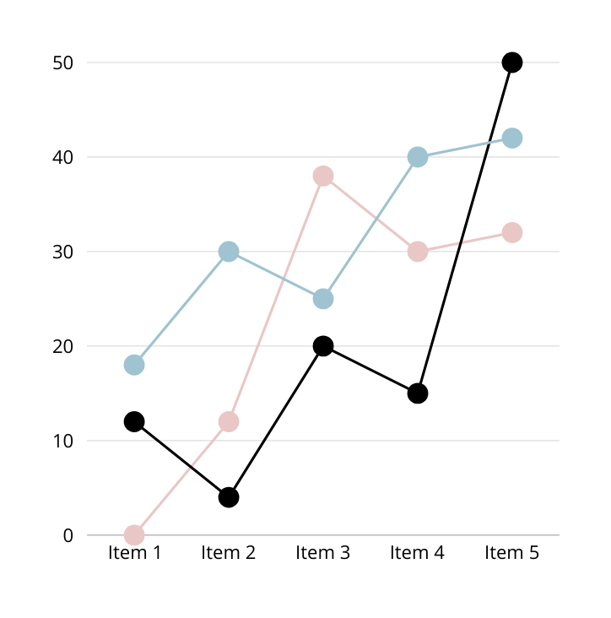
10
﻿RESULT
AICTE INTERNSHIP PROJECT

Slide 11
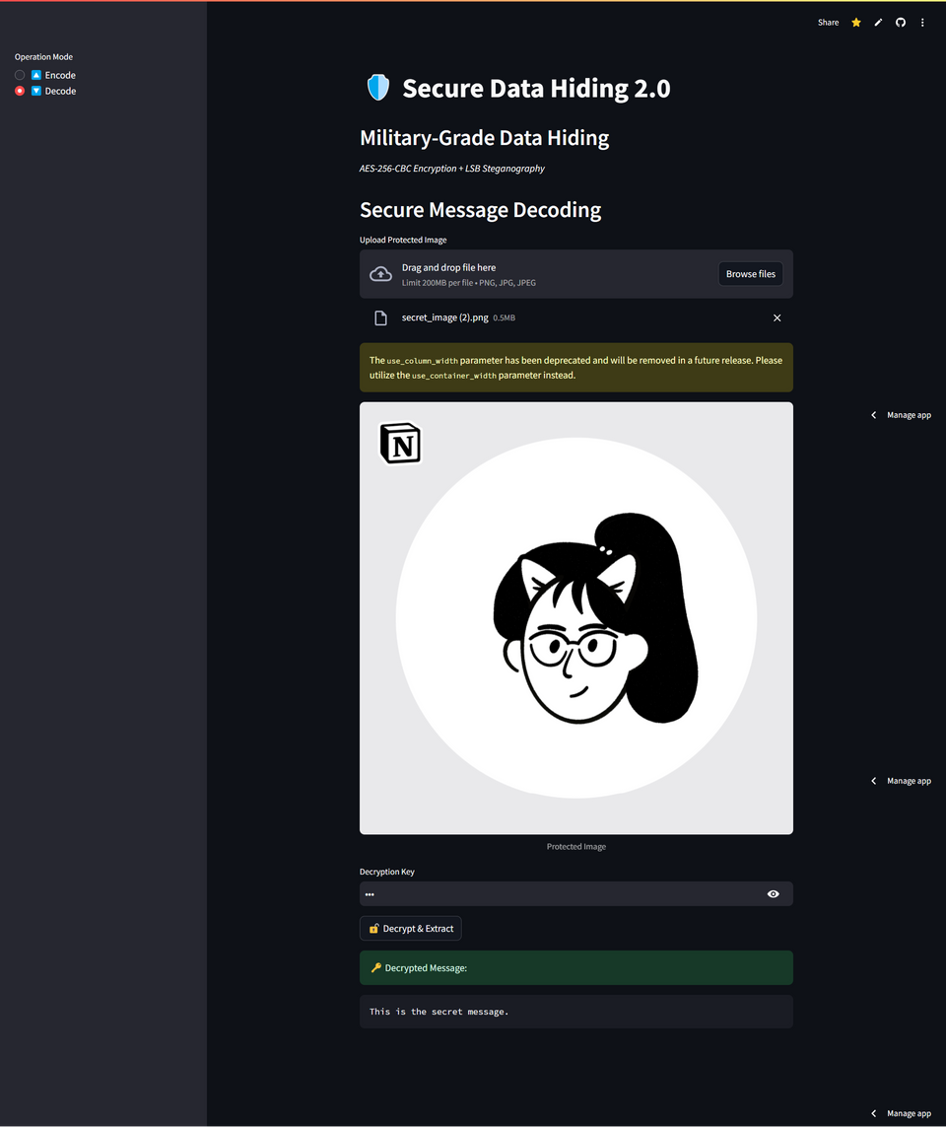

11
﻿RESULT
AICTE INTERNSHIP PROJECT

Slide 12
12
GITHUB LINK
Repository
https://github.com/x0lg0n/AICTE-INTERNSHIP-PROJETC
ReadMe File
AICTE INTERNSHIP PROJECT
https://github.com/x0lg0n/AICTE-INTERNSHIP-PROJETC/blob/master/README.md
Live Project
https://aicte-internship-projetc-4l2rcndpuyqhly3zjjsfau.streamlit.app/

Slide 13

CONCLUSION
13
The project successfully implements secure data hiding in images using AES encryption and LSB steganography .
It addresses the problem of secure data transmission by combining encryption and steganography.
The solution is robust, user-friendly, and suitable for real-world applications.
Future enhancements can include support for additional file formats and improved error handling.
AICTE INTERNSHIP PROJECT

Slide 14
14
FUTURE SCOPE
Extend support to other image formats like JPEG and BMP.
Implement multi-layer encryption for added security.
Develop a mobile application for on-the-go secure data hiding.
Explore AI-based steganalysis detection to test the robustness of the system.
AICTE INTERNSHIP PROJECT

Slide 15
15
THANK YOU
Presented By : Siddhartha Kunwar

